Slide 1

Or
Welcome….thank you for joining.
Your session begins @ 10AM

Slide 2







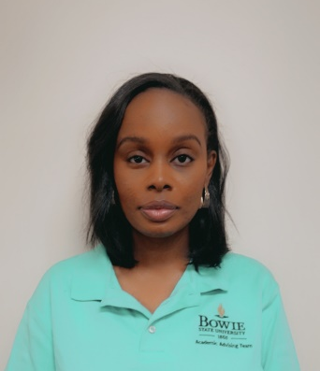

Academic Advising & DSS Team
Dr. Galloway
Director
Mr. Mosley
Advisor
Dr. Hughes
Coordinator, DSS
Ms. Murray
Adm Asst II
Dr. Goodman
Advisor
Ms. Alexander
Advisor
Ms. Gardner
Advisor
Mr. Wardrick
Advisor
Ms. Roebuck
Intake Specialist, DSS

Slide 3




Tips for Meeting Attendees
Enter your first & last name in the chat box.
Mute your microphone during presentation
Raise your hand when you have a question
We encourage use of camera

Slide 4
Learning Outcomes:
To gain an understanding of BSU academic policies and expectations of students.
To gain an understanding of BSU graduation requirements.
To receive your fall schedule of classes, learn to sign into Bulldog Connection (BDC) and introduction to BlackBoard our curriculum management platform
Learn to navigate the University

Slide 5
Quick Facts
BSU is a top 25 historically black university as reported by U.S. News & World Report
Oldest HBCU in Maryland
BSU is in the Top 20 schools on the list of 50 best colleges for African Americans (Money Magazine)
BSU is a top school for value among all Maryland colleges (The Economist)
Gender Distribution 62% female 38% male
5308 undergraduate students
868 freshmen (Fall 2019)
Established in 1865
BSU is Maryland’s top 5 university for graduating African Americans with bachelor’s degrees in biology and computer science/tech field (Diverse)
Accolades
#1 safest college or university campus in Maryland (YourLocalSecurity.com)

Slide 6

Cost of Attendance (Fall 2021)
In- State Tuition & Fees
(12 – 18 credits per semester)
Out- of- State Tuition & Fees
(12 – 18 credits per semester)
Tuition: $2,823.50
Fees: $1,399.10
Total p/semester: $4,281.60
**Does not include campus housing & meals
Tuition: $8,169.00
Fees: $1,399.10
Total p/semester: $9,649.10
**Does not include campus housing & meals
Graduate in Eight!
8 semesters @ 15 credits p/ semester = $34,252.80
10 semesters @ 12 credits p/semester = $42,816.00
Savings: $ 8,563.20
8 semesters @ 15 credits p/ semester = $77,192.80
10 semesters @ 12 credits p/semester = $96,491.00
Savings: $ 19,298.20

Slide 7
Payment Date
Your bill must be paid no later than:
August 15, 2021
To avoid being cancelled for non-payment you must pay your bill by the due date!
If you register after August 27th – you must pay the same day

Slide 8
Campus Resources

Slide 9
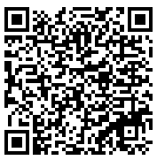
Disability Support Services
Disability Support Services (DSS) ensures that students with disabilities have full access to all programs and services at Bowie State University.
Services consist of, but are not limited to, extended time on tests, note takers, readers, taped texts, alternative testing, consultation with professors, physicians, psychologists and other specialists, vocational rehabilitation referrals, and sign language interpreters.
      Register for a DSS Information Sessions:
      May 18th and 25th
      June 15th and 29th
      July 13th and 27th
      August 10th and 17th
    All information sessions begin at 11:00AM
  Email Contact: dss@bowiestate.edu

Slide 10
Academic Support Services (Free)
Online Learning Management Platform. All online and hybrid courses are hosted on Blackboard.
Writing Center
The Writing Center at Smith Vidal Literacy and Language Center is devoted to helping you become a stronger and more confident writer.
Prisem Center
Campus-based tutoring support for undergraduate students. The Center’s staff works closely with faculty to help students overcome challenges in the classroom.
Smart Thinking
Career Development Center
SMARTHINKING is an online tutoring/support service, primarily intended for undergraduate course support.
Blackboard
Provides major explorations, career planning, job search assistance, and programs to assist students and alumni in making meaningful career, educational, and life choices.

Slide 11
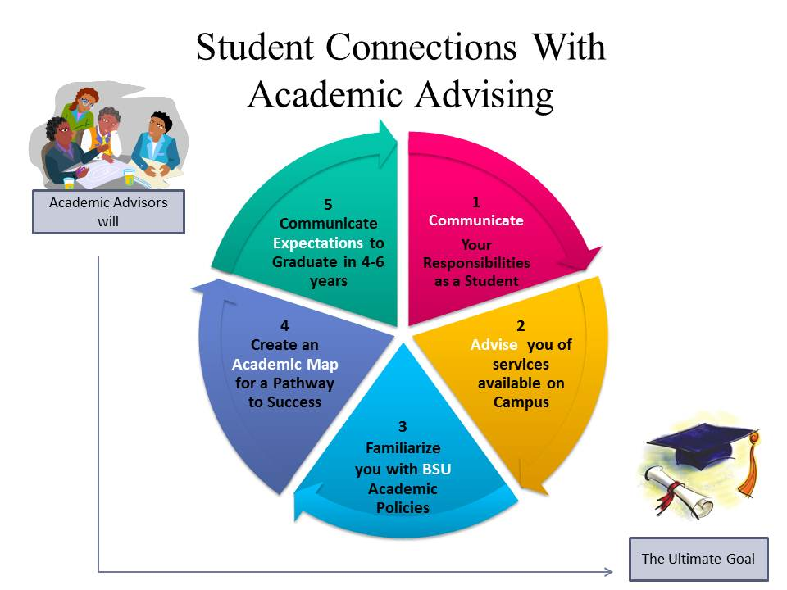
Academic Advising Center

Slide 12
Academic Advising Center (AAC)
  Students must meet with an academic advisor prior to registering for classes each semester.
  Academic advisors are not assigned; therefore, students may receive assistance from any available advisor.
  Walk-in advising available during non-peak times.
  Appointment required during peak seasons:
    March 15 - May 15
    October 15 – December 15
  Virtual and face-to-face appointment options available

Slide 13
Academic Advising Center (AAC)
  ACC provides academic advising for most students having earned between 0 – 59 credits, except for:
      Education – 0 - 44 credits
      Nursing – 0 - 29 credits
  The following majors are advised by the AAC Center upon entry and immediately transition to faculty advising during the first semester:
      Computer Science
      Computer Technology
      English
      Social Work

Slide 14
Colleges & Majors
College of Arts and Sciences
College of Business
Biology
Bio-Informatics
Chemistry
Communications
Computer Science
Computer Technology
English & Modern Languages
Fine Arts
History & Government
Mathematics
Science Education
Theatre Arts
Visual Communications & Digital Media Arts (VCDMA)
Business Administration
Concentrations:
    Accounting
    Banking & Finance
    Business Information Systems
    Data Analytics
Economics
General Business
Management
Marketing
Small Business/ Entrepreneurship
College of Education
College of Professional Studies
Early Childhood/Special Education
Elementary Education
Sport Management
Child & Adolescent Studies
Criminal Justice
Nursing
Psychology
Social Work
Sociology
Degrees Offered: Bachelor of Arts, B. A
Bachelor of Science, B. S.

Slide 15
Student Classification
      Freshman 0 – 29 credits
      Sophomore 30 – 59 credits
      Junior 60 – 89 credits
      Senior 90 – 120 credits

Slide 16
FINISH IN 4 INITIATIVE
      Recommended Credit Load = 15 credits
      p/ semester
      Minimum full time load = 12 credits p/semester
      Part-time load = < 12 credits p/semester
      Maximum Credit Load = 18 credits p/semester
      With GPA of 3.5 and 30 credits completed at BSU, students may take up to 21 credits p/semester with permission of College Dean

Slide 17
General Education Requirements
English 101 | 3 credits
English 102 | 3 credits
Arts & Humanities | 6 credits
Social & Behavioral Science | 6 credits
Natural Science | 7 – 8 credits
Mathematics | 3 credits
Technology | 3 credits
Free Gen Ed Requirements | 9 credits
Institutional Requirements:
Health & Wellness | 3 credits
Freshman Seminar | 3 credits
Core (Major) Requirements: 74 – 78 credits
Total Baccalaureate Degree requirement: 120 credits
Know your program of study – the catalog you enter under is your contract with the University!

Slide 18
Academic Policies

Slide 19
Important Academic Polices
Unsatisfactory Academic Performance
Students earning a cumulative (cum) GPA of 2.0 or less are placed on:
  Academic Warning: after one semester below a 2.0 cum gpa
  Academic Probation: after two consecutive semesters below a 2.0 cum gpa
  Academic Dismissal: after three consecutive semesters below a 2.0 cum gpa

Slide 20
Important Academic Polices
Financial Aid: Satisfactory Academic Progress (SAP)
  Students must maintain at least a 2.0 GPA each semester.
  Students must pass at least 67% of credits attempted annually.
  “F” grades, Withdrawals and Audits are attempts that count against you.
  Maximum time frame to receive financial aid is 180 credits or
  12 academic semesters, whichever occurs first.
Failure to meet these standards may result in the
cancellation of all financial aid awards

Slide 21
Important Academic Policies
  Academic Dishonesty includes these offenses and can
  carry serious penalties:
    Plagiarism - the most reported offense
      Improper or no acknowledgement of sources
    Cheating on exams
    Unauthorized Collaboration
    Submitting duplicate assignments in more than one class
Each faculty member deals directly with academic infractions.
Penalties can range from failing the assignment, failing the course, suspension, or dismissal.

Slide 22
Important Academic Polices
    Class attendance and participation is mandatory.
    Failure to officially withdraw from a class you are no longer attending will result in a grade of “F”.
    You have up to 10 weeks from the start of the semester to withdraw from a 16 week course.
    Withdrawals are a self-service function. Log into Bulldog Connection to process a class drop.
    Should you decide to leave the University while enrolled in classes complete an official Withdrawal Data Sheet, obtain appropriate signatures and submit to the Registrar’s office.

Slide 23
Things to Know

Slide 24
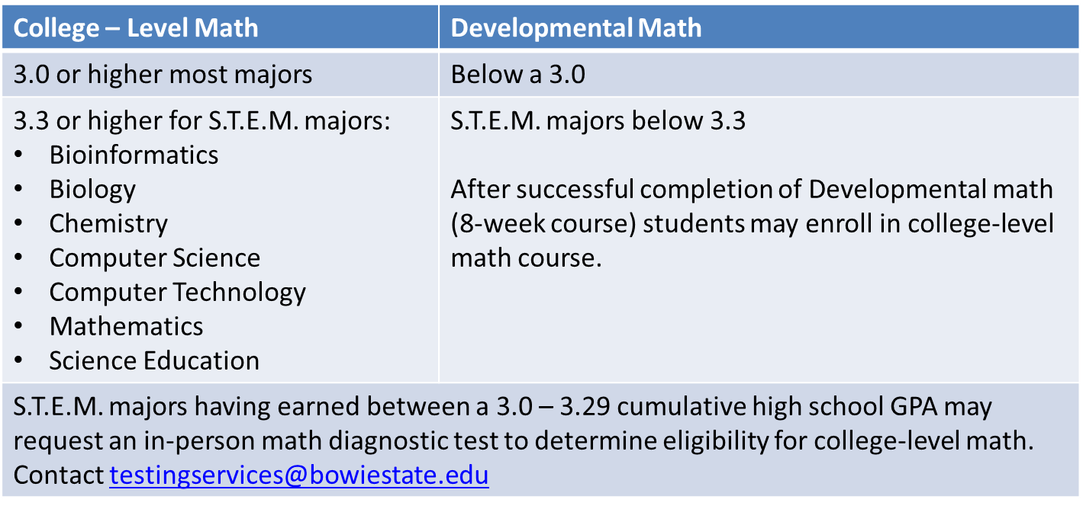
English & Math Placement
Fall 2021 admits will not take placement exams
All new freshman will enroll in college-level ENGL 101
Math placement is based on your high school cumulative GPA:

Slide 25
Next Steps…
1
2
3
Submit your Immunization Records to the Wellness Center.
Immunization records must be submitted prior to coming to campus. Email Medical Form to: hwwc@bowiestate.edu
Complete the Family Educational Rights and Privacy Act (FERPA) form. https://www.bowiestate.edu/about/administration-and-governance/division-of-enrollment-management/registrars-office/student-privacy-ferpa.php
Signed form gives University permission to share student information
Visit our Bookstore website https://www.bkstr.com/bowiestatestore/home
Check your course syllabus to confirm textbook use prior to refund deadline
Textbooks may be purchased or rented from the Bookstore or online vendors.

Slide 26
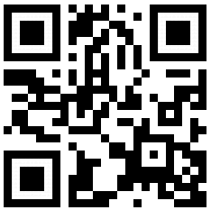
Next Steps…continued
4
Pay for Parking - $68.00 commuter/$69.00 resident. (possible increase)
No cars for freshmen living on campus.
5
Sign up for BEES - BSU’s Electronic Emergency Alert System
Scan the QR code or go to: bit.ly/BSUbees

Slide 27
Important Dates to Remember
August 30: First Day of Classes
August 30 – Sept 10: Late Registration
September 10: Last Day to Add/Drop a 16 week class
September 15: Fall 2021 Convocation
October 18-22: Mid -Term Exams
October 25: Academic Advising Begins (Academic Advising Center)
November (pending): Academic Advising in the Departments
November (pending): Winter/Spring 2022 Registration Opens
November (pending): Last Day to Audit or Withdraw for class
December (pending): Last Day of Classes
December (pending): Final Exams

Slide 28
Submit transcripts for dual credit course work, check on status of transcripts.
Financial Aid
Check on status of financial aid award.
Student Accounts
Registrar
Residence Life
FERPA form, course schedule modifications
Admissions
Important Offices to Contact
financialaid@bowiestate.edu
ugradadmissions@bowiestate.edu
Set up payment arrangements, pay on your account
Apply for housing, check on status of housing application
housing@bowiestate.edu
sa@bowiestate.edu
registrar@bowiestate.edu

Slide 29

Attendance Check

Slide 30
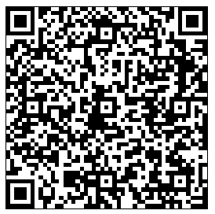

Thank you for attending!
Tell us about your advising experience:
Questions? Contact: newstudentadvising@bowiestate.edu
Follow us on Instagram:
@Bowiestateadvising

Slide 31
Breakout Sessions
If you have not registered for any of your classes, please join our Registration Assistance Breakout

Slide 32
Breakout Sessions
All remaining students may move to a Q & A
Breakout based on your Last name.
Last Name | Advisor
A - D | Ms. Gardner
E - J | Ms. Alexander
K - Q | Mr. Mosley
R - Z | Mr. Wardrick

