Slide 1
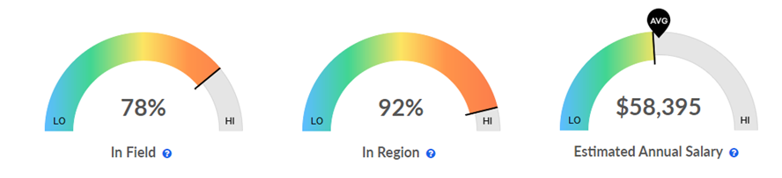
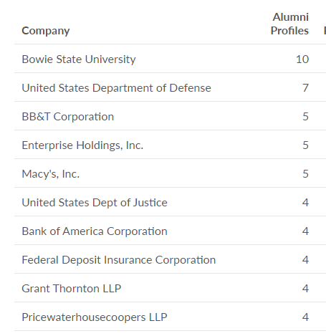
Alumni Outcomes
2017-2018 graduates
Business Administration (Bachelor)
Source: EMSI Alumni Outcomes

Slide 2
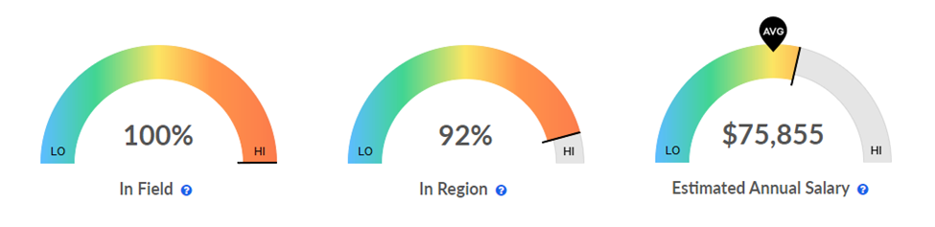
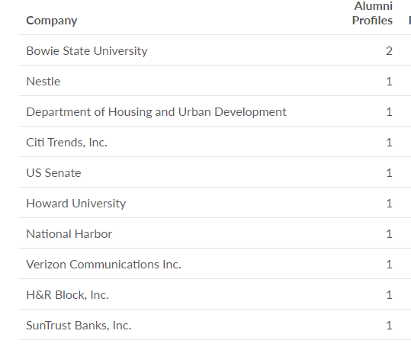
Alumni Outcomes
2017-2018 graduates
Business Administration (MBA)
Source: EMSI Alumni Outcomes

